Slide 1
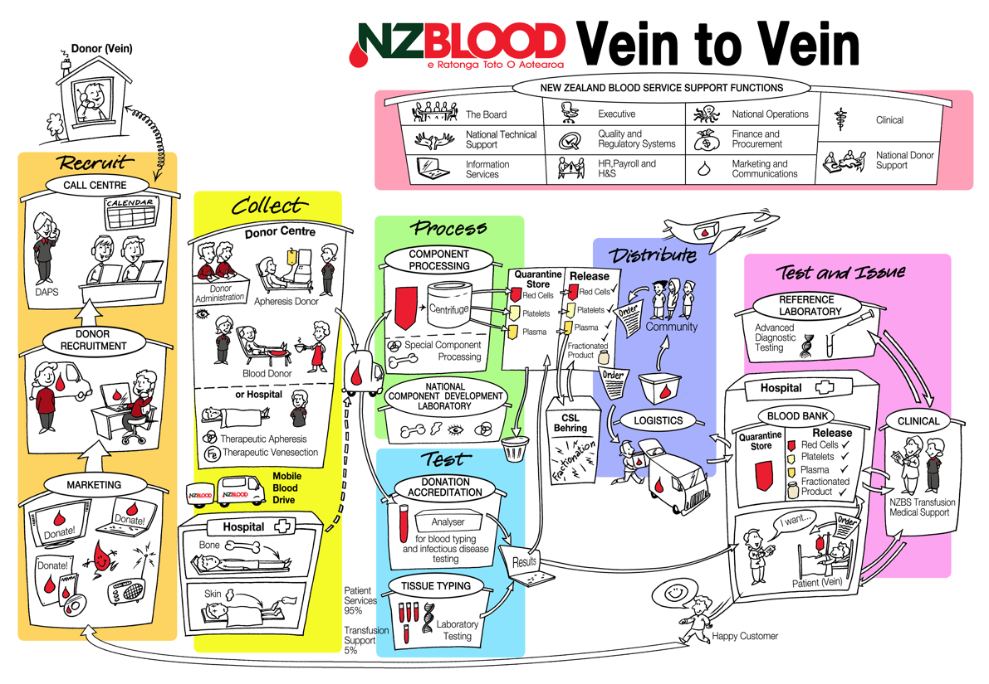
2015 Haemovigilance Report
Tables and Figures

Slide 2
TABLE 2.1 COMPARISON HAEMOVIGILANCE REPORTS : COMPONENTS TRANSFUSED 2007 – 2015

Slide 3
FIGURE 2.1 ANNUAL NUMBER OF TRANSFUSION-RELATED ADVERSE EVENTS 2006 – 2015

Slide 4
TABLE 3.1 ANNUAL NUMBER OF BLOOD COMPONENTS TRANSFUSED 2010 – 2015

Slide 5
TABLE 3.2 ANNUAL RATE OF BLOOD COMPONENTS TRANSFUSED PER 1,000 NEW ZEALAND POPULATION
2010 – 2015

Slide 6
TABLE 3.3 ANNUAL NUMBER OF RED CELL, PLATELET AND FRESH FROZEN PLASMA RECIPIENTS 2010 – 2015

Slide 7
TABLE 3.4 BLOOD COMPONENT TRANSFUSION RATES BY DISTRICT HEALTH BOARD 2015

Slide 8
TABLE 4.1 RECIPIENTS OF BLOOD COMPONENTS 2015

Slide 9
TABLE 4.2 ANNUAL MEAN PRETRANSFUSION HAEMOGLOBIN CONCENTRATION 2006 – 2015

Slide 10
FIGURE 4.1 ANNUAL MEAN PRETRANSFUSION HAEMOGLOBIN CONCENTRATION 2006 – 2015

Slide 11
TABLE 5.1 TRANSFUSION-RELATED ADVERSE EVENTS (IMPUTABILITY ≥3) 2015 BY REPORTING DISTRICT HEALTH BOARD

Slide 12
FIGURE 5.2 TRANSFUSION-RELATED ADVERSE EVENTS (IMPUTABILITY ≥3) 2015 BY REPORTING DISTRICT HEALTH BOARD

Slide 13
TABLE 6.2 TRANSFUSION-RELATED ADVERSE EVENTS OF LOW ≤2 IMPUTABILITY 2009 – 2015

Slide 14
TABLE 6.3 TRANSFUSION-RELATED ADVERSE EVENTS OF LOW ≤2 IMPUTABILITY 2009 – 2015 BY EVENT TYPE

Slide 15
TABLE 6.4 TRANSFUSION-RELATED ADVERSE EVENTS 2015 BY EVENT TYPE AND IMPUTABILITY SCORE

Slide 16
FIGURE 6.1 TRANSFUSION-RELATED ADVERSE EVENTS (IMPUTABILITY ≥3) 2015 BY EVENT TYPE
Key:
FNHTR Febrile non-haemolytic transfusion reaction
Allergic Allergic transfusion reaction
TACO Transfusion-associated circulatory overload
UCT Unclassifiable complication of transfusion
DSTR Delayed serologic transfusion reaction
IBCT Incorrect blood component transfused
AHTR Acute haemolytic transfusion reaction
DHTR Delayed haemolytic transfusion reaction
TAD Transfusion-associated dyspnoea
CR Component related
TRALI Transfusion-related acute lung injury
TTI Transfusion-transmitted infection

Slide 17
FIGURE 6.2 TRANSFUSION-RELATED ADVERSE EVENTS (IMPUTABILITY ≥3) 2015 BY EVENT TYPE

Slide 18
TABLE 7.2 TRANSFUSION-RELATED ADVERSE EVENTS (IMPUTABILITY ≥3) 2015 BY EVENT TYPE AND SEVERITY

Slide 19
TABLE 8.1 TRANSFUSION-RELATED ADVERSE EVENTS (IMPUTABILITY ≥3) 2015 BY BLOOD COMPONENT TYPE

Slide 20
TABLE 8.2 TRANSFUSION-RELATED ADVERSE EVENTS (IMPUTABILITY SCORE ≥3) 2015 BY EVENT TYPE AND BLOOD COMPONENT TYPE

Slide 21
TABLE 9.1 FNHTR EVENTS (IMPUTABILITY ≥3) 2015 BY RECIPIENT GENDER
TABLE 9.3 SERIOUS FNHTR EVENTS (IMPUTABILITY ≥3) 2015 BY RECIPIENT GENDER

Slide 22
TABLE 9.2 FNHTR EVENTS (IMPUTABILITY ≥3) 2015 BY ASSOCIATED SIGNS AND SYMPTOMS

Slide 23
TABLE 10.2 ALLERGIC EVENTS (IMPUTABILITY ≥3) 2015 BY ASSOCIATED SIGNS AND SYMPTOMS

Slide 24
TABLE 10.3 ALLERGIC EVENTS (IMPUTABILITY ≥3) 2015 BY BLOOD COMPONENT TYPE

Slide 25
FIGURE 12.1 ANNUAL NUMBER OF TRALI EVENTS 2005 – 2015

Slide 26
TABLE 12.1 COMPONENTS IMPLICATED IN TRALI EVENTS 2005 – 2015

Slide 27
TABLE 13.1 TACO EVENTS (IMPUTABILITY ≥3) 2015 BY RECIPIENT GENDER

Slide 28
TABLE 13.2 TACO EVENTS (IMPUTABILITY ≥3) 2015 BY ASSOCIATED SIGNS AND SYMPTOMS

Slide 29
TABLE 13.3 COMPONENTS IMPLICATED IN TACO EVENTS (IMPUTABILITY ≥3) 2007 – 2015

Slide 30
TABLE 13.4 ANNUAL NUMBER OF TACO EVENTS (IMPUTABILITY ≥3) 2010 – 2015

Slide 31
TABLE 13.5 SEVERE TACO EVENTS (IMPUTABILITY ≥3) 2010 – 2015

Slide 32
TABLE 14.1 ANNUAL NUMBER OF TAD EVENTS (IMPUTABILITY ≥3) 2008 – 2015

Slide 33
TABLE 15.1 COMPONENTS IMPLICATED IN HYPOTENSIVE EVENTS (IMPUTABILITY ≥3) 2009 – 2015

Slide 34
TABLE 16.1 DELAYED TRANSFUSION REACTIONS (IMPUTABILITY ≥3) 2015 BY EVENT TYPE AND RECIPIENT GENDER

Slide 35
TABLE 16.2 DELAYED TRANSFUSION REACTIONS (IMPUTABILITY ≥3) 2015 BY SPECIFICITY OF RED CELL ANTIBODY

Slide 36
TABLE 19.1 REPEAT REACTIVE DONOR LOOKBACK INVESTIGATIONS 2015 BY INFECTION TYPE

Slide 37
TABLE 20.1 TRANSFUSION-RELATED ADVERSE EVENTS (ANY CAUSALITY) 2015 ASSOCIATED WITH FRACTIONATED PLASMA PRODUCTS

Slide 38
TABLE 20.2 TRANSFUSION-RELATED ADVERSE EVENTS (ANY CAUSALITY) 2015 ASSOCIATED WITH INTRAGAM®P

Slide 39
TABLE 21.1 IBCT EVENTS 2015

Slide 40
TABLE 22.1 NEAR MISS EVENTS 2015 BY ERROR TYPE AND SITE

Slide 41
TABLE 23.1 NZBS WBIT EVENTS 2015 BY BLOOD BANK SITE

Slide 42
TABLE 23.2 NZBS WBIT EVENTS 2007 – 2015 BY BLOOD BANK SITE

Slide 43
FIGURE 23.1 ANNUAL NZBS WBIT EVENT RATE 2007 – 2015

Slide 44
TABLE 24.1 COMPARISON OF TWO DIFFERENT CULTURE SYSTEMS

Slide 45
TABLE 25.1 DONORS WITH CONFIRMED POSITIVE INFECTIOUS DISEASE SEROLOGY 2015

Slide 46
FIGURE 25.1 ANNUAL NUMBER OF DONORS WITH CONFIRMED POSITIVE INFECTIOUS DISEASE SEROLOGY 2000 – 2015

Slide 47
TABLE 26.1 ANNUAL NUMBER OF BLOOD DONATIONS 2005 – 2015 BY DONATION TYPE

Slide 48
FIGURE 26.1 ANNUAL DONATION-RELATED ADVERSE EVENT RATE PER 10,000 DONATIONS 2005 – 2015

Slide 49
TABLE 26.2 DONATION-RELATED ADVERSE EVENTS 2015 BY COLLECTION METHOD

Slide 50
TABLE 26.3 DONATION-RELATED ADVERSE EVENTS 2015 BY REACTION TYPE

Slide 51
TABLE 26.5 WHOLE BLOOD DONATION-RELATED ADVERSE EVENTS 2015 BY REACTION TYPE FOR NEW AND REPEAT DONORS

Slide 52
TABLE 26.6 WHOLE BLOOD DONATION-RELATED ADVERSE EVENTS 2015 BY DONOR AGE GROUP

Slide 53
TABLE 26.7 WHOLE BLOOD VASOVAGAL EVENTS 2015 BY DONOR AGE GROUP FOR NEW DONORS AND REPEAT DONORS

Slide 54
TABLE 26.8 DONATION-RELATED ADVERSE EVENTS ASSOCIATED WITH CITRATE TOXICITY DURING PLATELETPHERESIS 2013 – 2015

Slide 55
TABLE 27.2 PRETRANSFUSION REQUEST FORM AND SPECIMEN LABELLING ERRORS 2015 BY NZBS BLOOD BANK SITE

Slide 56
FIGURE 27.1 PRETRANSFUSION REQUEST FORM AND SPECIMEN LABELLING ERROR RATE PER 1,000 SPECIMENS 2009 – 2015

Slide 57
TABLE 27.4 PRETRANSFUSION SAMPLE RECOLLECTION REQUESTS 2015 BY NZBS BLOOD BANK SITE

